Slide 1

Automatically Detecting Vulnerable Websites Before They Turn Malicious Kyle Soska and Nicolas Christin, Carnegie Mellon University
Presented By: Kartik Khanna

Slide 2
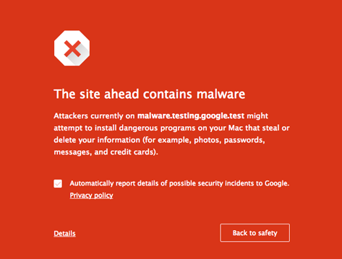
ABSTRACT
In this paper, we take a complementary approach, and attempt to design, implement, and evaluate a novel classification system which predicts, whether a given, not yet compromised website will become malicious in the future
Techniques Used:
Data Mining
Machine Learning

Slide 3
SOME DEFINITION
Content Management System- It is a bundled or stand-alone application to create, deploy, manage and store content on Web pages
Search Redirection Attack- Hackers will compromise the website and will force the website into malicious malware distribution
Composite Importance (CompImp) - Which is an information-based measure of how important the node is in HTML style tree
Values closer to 1 means that node is unique to all the pages in the website

Slide 4
End Host Malware vs Webserver Malware
End Host- Attacker to take over the victim’s computer for a variety of purposes
Webserver- Instead of targeting arbitrary hosts for compromise, the attacker attempts to inject code on machines running web servers
Exploits outdated or unpatched versions of popular CMS
Participate in search-engine poisoning or redirection campaigns promoting questionable services or to act as a delivery server for malware

Slide 5
Motivation Behind The Research
Search engines, that need to be able to assess whether or not they are linking to potentially risky contents
For blacklist operators, who can obtain ahead of time a list of sites to keep an eye on
Of course for site operators themselves

Slide 6
CONTENTS
How the Classifier was build
Properties
Learning Process
Describe Evaluation and Methodology used
Data Sources
Filtering
Feature Extraction
Results
Limitation

Slide 7
SYSTEM PROPERTIES
Efficiency
Internet as our dataset
Interpretability
Why and how the classifier arrived at the prediction
Robustness to Imbalanced Data
Far more benign examples than malicious ones - the more imbalanced the datasets, the more learning is impacted
Robustness to Mislabeled Data
There is little or no information about unpopular websites
Adaptive
Internet requires constant adaptation

Slide 8
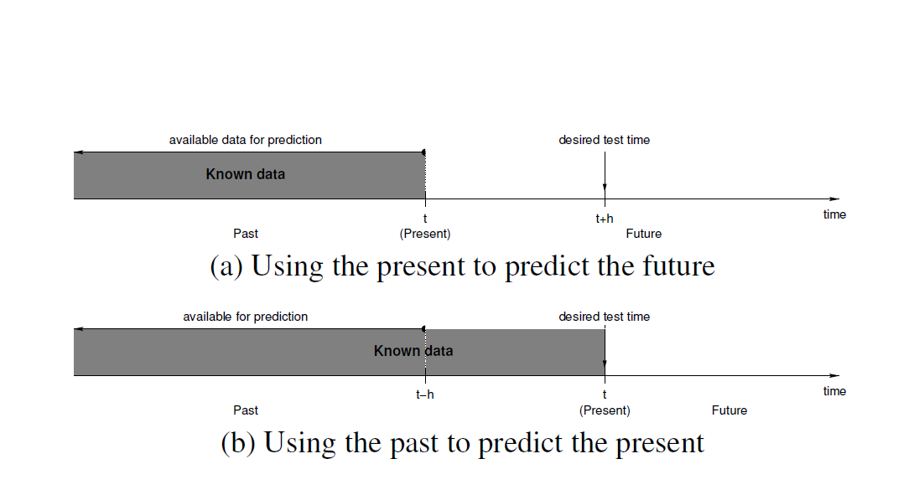
LEARNING PROCESS
Lack Of Knowledge Of The Future
Problems in present to predict future
How to decide the value of h
Solution
Using past features of the website and comparing it with the present to see if it has become malicious or not
List Of Features used :
Traffic Statistics : Sudden change in the popularity - Redirection Attack? – Stats available on alexa.com/topsites
Filesystem Structure : Directory hierarchy - Certain files
Webpage Content : Type of CMS used – Filtering out the template

Slide 9
SYSTEM DESIGN
Blacklist
Malicious Sites
Archive.org
Alexa.com
Template Filter
Feature Extraction
Zone Files
Safe Sites
Stream Classifier

Slide 10
DATA SETS
Type | Instances | Archived Instances | % Archived
PhishTank | 91,555 | 34,922 | 38.1
Search Redirection* | 16,173 | 14,425 | 89.2
.com Zone Files | 336,671 | 336,671 | N/A
PhishTank: Feb 2013 – Dec 2013
Search Redirection: Oct 2011 – Sept 2013
Zone Files: Feb 2010 – Sept 2013
10

Slide 11
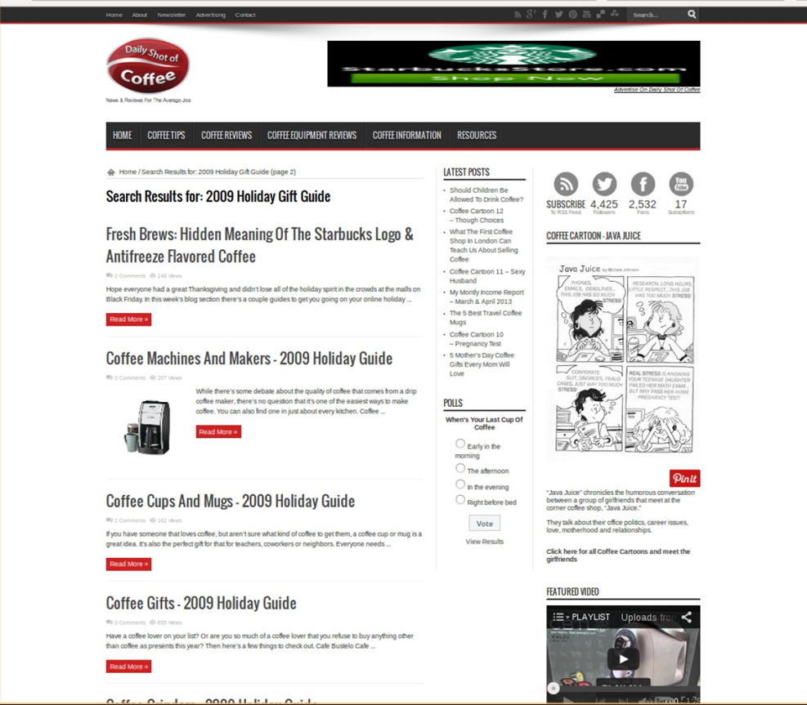

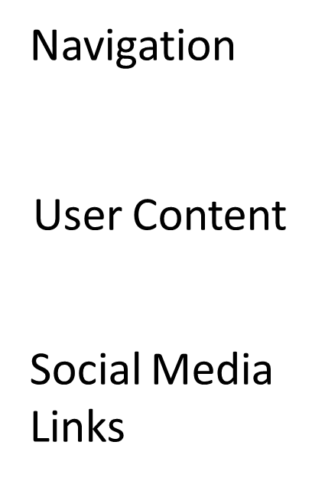

FILTERING

Slide 12
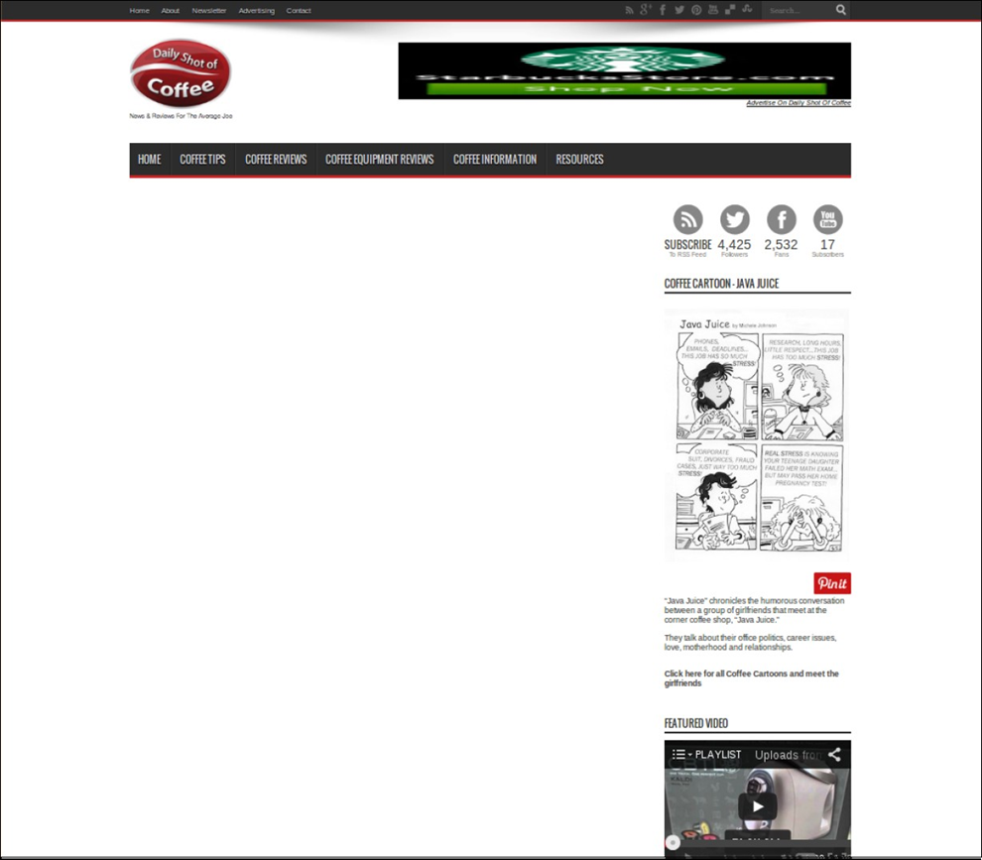
Complmp >0.99

Slide 13
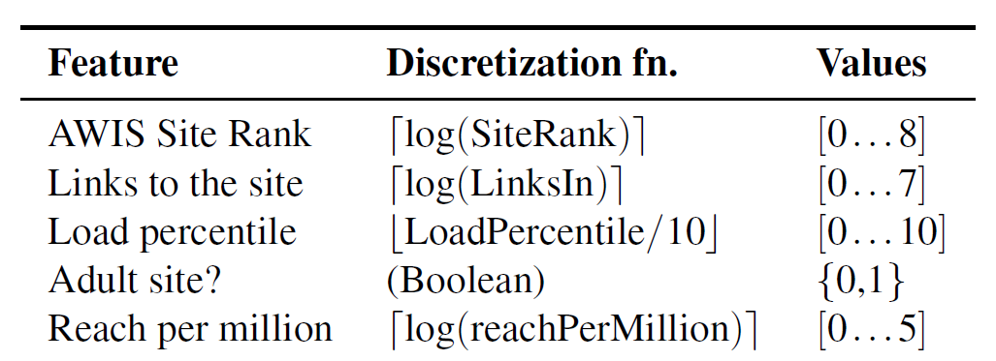
FEATURE EXRTACTION
AWIS Feature
-It gives some features about the popularity of the website
-Why? – Attackers may target those websites to make their own malicious website in turn popular
Dealing With Missing Value
- Either give most common value
- Randomly assign some

Slide 14

Content Feature
Parsed into set of HTML tags
The tags from all the pages in a site were then aggregated into a list without repetition
Count a particular tag from both positive and negative sites
After adding information from every 5,000 sites to the dictionary, we purged from the dictionary all tags that had appeared only once
where B and M are the set of benign, and malicious websites, respectively; the notation x -> w means that the tag x is present in the tag dictionary associated with website w
Accuracy Balanced Statistic

Slide 15
Prominent Features After 90,000 Samples
Feature | Statistic Value
meta{‘content’: ‘Wordpress 3.2.1’, ‘name’: ‘generator’} | 0.0569
ul{‘class’: [‘xoxo’, ‘blogroll’]} | 0.0446
You can start editing here. | 0.0421
meta{‘content’: ‘Wordpress 3.3.1’, ‘name’: ‘generator’} | 0.0268
/all in one seo pack | 0.0252
span{‘class’: [‘breadcrumbs’, ‘pathway’]} | 0.0226
If Comments are open, but there are no comments. | 0.0222
div{‘id’: ‘content_disclaimer’} | 0.0039

Slide 16
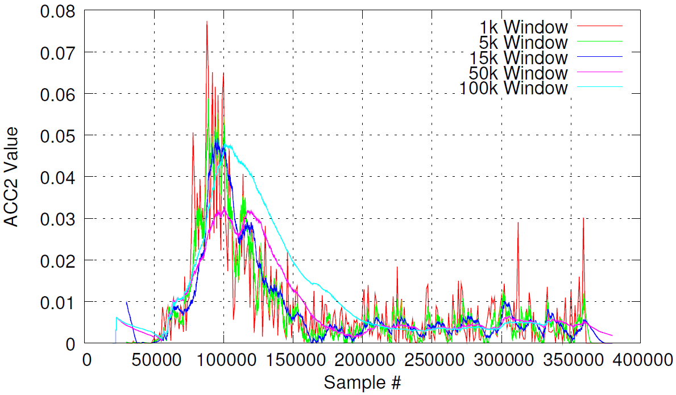
Results
1. Dynamic Features
Varying Window Sizes
Feature: meta{‘content’: ‘Wordpress 3.2.1’, ‘name’: ‘generator’}

Slide 17
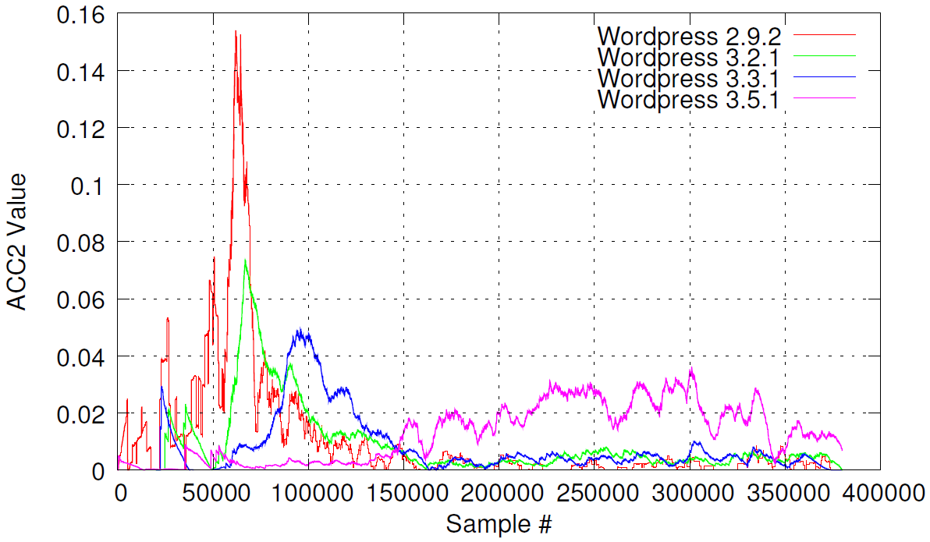




CMS Evolution
Attack Campaign
Attack Campaign Attack Campaign
Low Activity

Slide 18
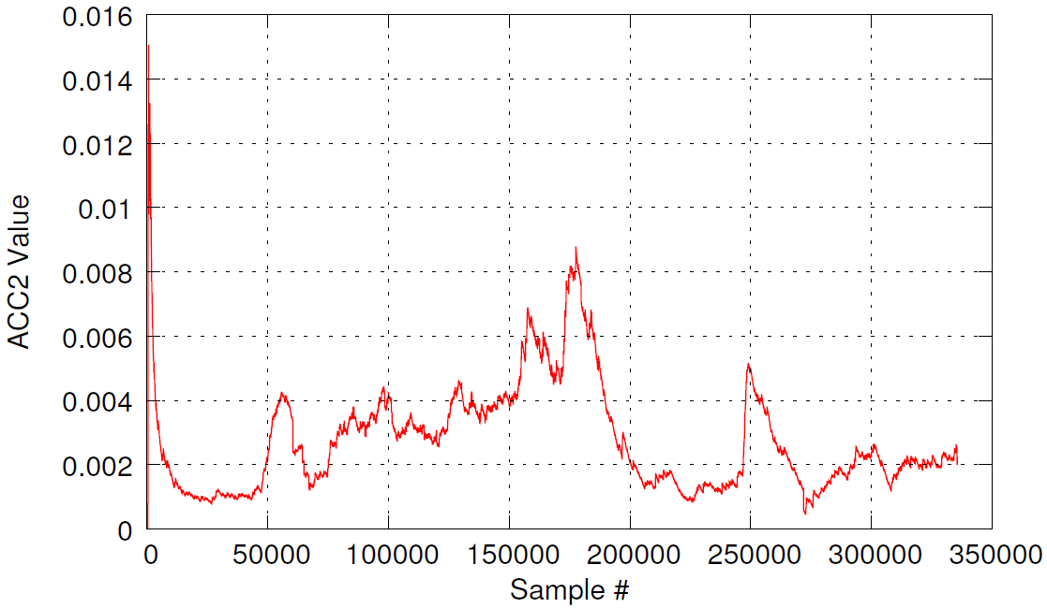

Benign Website
Similar value over 1 year later!
Feature: div{‘id’: ‘content_disclaimer’}

Slide 19
CLASSIFICATION
Content Features
Recomputed Features
Dynamic Features
Input (websites)

Slide 20
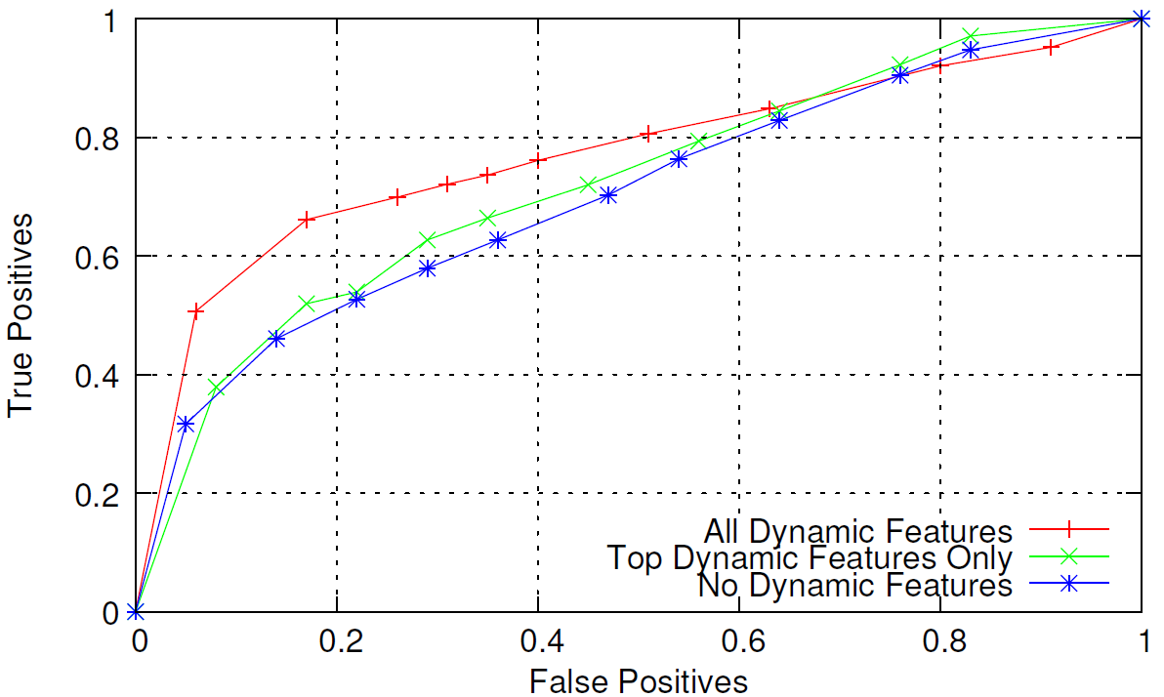

2. Classification Results
Good Operating Point

Slide 21
LIMITATIONS
Only makes sense when page content and traﬃc statistics are risk factors of malice
Sites hacked via weak passwords or via social engineering attacks violate this
Sites that are maliciously hosted may violate this
Requires some sites to become compromised in order to make predictions

Slide 22
THANK YOU

